Slide 1


Assessing Flooding Hazard Exposure
Walter Gillis Peacock peacock@tamu.edu
Douglas Wunneburger d-wunneburger@tamu.edu
Alexander Abuabara abuabara@tamu.edu
Sep 18, 2023

Slide 2
Presentation Outline
FEMA flood hazard data
Geoprocessing: data cleaning and reclassification
Case study to illustrate this process and quantification of exposed elements
Conclusions and some possible alternatives to assess flooding exposure

Slide 3
Flood Hazard Data Sources
A hazard can be studied in different ways:
By models or simulation of extreme events (deterministically or stochastically);
Engineering or physics-based models (hydrological and hydraulic).
By specific occurrences (historical events, but often not well documented, even today).
By local knowledge.
FEMA provides flood hazard data to support the National Flood Insurance Program (NFIP).
National Flood Hazard Layer (NFHL) is a geospatial database that contains current effective flood hazard data for a variety of official policies/programs.
These data establish flood insurance requirements (often imposed by federally backed mortgage lenders).
Help communities develop strategies and programs to reduce flood risk, understanding risk exposure and evaluating/quantifying exposure.
NFHL data is not uniformly available, but covers the area occupied by 90% of US population.

Slide 4
History of FEMA Flood Maps
In 1968 the US Congress created the NFIP.
FEMA has been creating and updating flood hazard maps for the program after its creation.
These maps are based on the combination of a variety of methods: historical occurrences and insurance claims; meteorological, hydrologic, and hydraulic data; and can incorporate assessment of land-use/land cover conditions, flood-control infrastructure, and development.
Updates to flood maps are a collaboration between the communities and FEMA.
Every community that participates in the NFIP has a floodplain administrator who works with FEMA during the mapping process.
After their creation they are subject to public review/comment, amendment, prior to adoption.

Slide 5
History of FEMA Flood Maps
Over time, FEMA has produced two digital flood map products
Paper Maps | Q3 Flood Data | DFIRM (Digital Flood Insurance Rate Maps)
Flood Hazard Boundary Maps (FHBM), later Flood Insurance Rate Maps (FIRM). Essential tool for the Mitigation Directorate (now the Federal Insurance and Mitigation Administration (FIMA), responsible for the NFIP and a range of programs designed to mitigate against future losses from all hazards including floods, earthquakes, tornadoes, and other natural disasters. | Started as digitization of paper maps, for the entire US. Less precise scale 1:24,000 (±40 ft.) Was available for over 1,300 counties Q3 cannot be used as the official NFIP map for site design or flood risk determinations. Last updated late 1999. | Started in 2000. More precise scale 1:12,000 (±33 ft.) NFHL (National Flood Hazard Layer) geospatial database. New counties and updates to existing ones are an ongoing process. Currently covers the area occupied by 90% of US population.

Slide 6
Current FEMA Websites
FEMA Flood Map Service Center
https://msc.fema.gov/portal/home
Dynamic map
Document/letters of revisions, amendments, and revalidations
National Flood Hazard Layer (NFHL) Status
https://www.floodmaps.fema.gov/NFHL/status.shtml
NFHL inventory: table with the most updated DFIRMs for download (by county)

Slide 7
Observations Regarding the NFHL Data
Areas likely to have additional wave action (flood with velocity are identifiable).
Generally speaking, there is limited flood depth data;
Some flood classifications indicate depth ranges, but mostly they reflect a dichotomous classification.
NFHL boundaries are not perfectly aligned with Census TIGER shapefiles.
Data are presented by county, but county boundaries (and hence other geographies) can be inconsistent with Census boundaries.
Since flooding designations are distributed county by county, neighboring, cross-county areas, can have different flood risks.
This can be potentially problematic when places, cities, metro-areas, are cross counties.
Data are presented to capture probabilities of flooding, annual exceedance probability.

Slide 8
FEMA Floodplain Designations
Special Flood Hazard Areas (SFHA)
Areas subject to flood inundation at 1.0% or greater chance in any given year.
Sometimes referred to as having a 1.0% chance of flooding per year.
“100-year floodplain”
Moderate Flood Hazard Areas
Areas subject to flood inundation between the limits of the SFHA and 0.2% chance of flooding in any given year.
“500-year floodplain”
Areas of Minimal Flood Hazard
Areas outside the SFHA and higher than the elevation of the 0.2% chance of flooding in any given year.

Slide 9
Floodplain Reclassification
Q3 and NFHL flood zones and subtypes and our simplified recodes …
Q3 classification | NFHL classification | Reclassification*
V, VE | VE | 100-year (with velocity)
A, A1-A30, A99, AE, AH, AO, AR | A, AE, AH, AO | 100-year
B, X500, X (shaded) | X (0.2 pct annual chance flood hazard) | 500-year
X (reduced flood risk due to levee) | Area with reduced flood risk due to levee | Levee protected
C, D, X, X (unshaded), UNDES | X (area of minimal flood hazard), ANI (area not included) | Out of the floodplain
Many sources ... ultimately referring to FEMA, such as:
- https://help.riskfactor.com/hc/en-us/articles/360048256493-Understand-the-differences-between-FEMA-flood-zones
- http://www.floodmaps.com/zones.htm
- http://www.mass.gov/anf/docs/itd/services/massgis/q3floodzonescodetable.pdf

Slide 10
Data Cleaning and Geoprocessing
Load, tidy, reclassify, dissolve, adjust and water subtraction, and quantification of exposure
Census feature geometries for the study area (and estimates)
Simplify water geometries (drop crumbs, fill holes to a certain threshold (~0.01 km²), and dissolve)
Facilitates work in our personal computers
Object size becomes ~35% of its original
Avoid topological errors
Local GIS parcel data
(filter for residential with improvements)
LandScan
(crop and mask to the county boundary box)
FEMA NFHL areas
Cleaning (check column names, projection, and flood zones and zones sub-types)
Reclassification and dissolve by our recodes
Adjusts
(crop to adjust to Census boundaries and subtraction of water areas)
Spatial intersection
(estimate areas and hazard exposure)
Validate results and export tables and maps

Slide 11
Case Study: Flooding Hazard Exposure in Galveston Co.
R-script for this case study: https://github.com/abuabara/flooding_hazard_exposure.git
Data sources
Census boundaries and perennial and intermittent areas of hydrography features
R/tigris https://github.com/walkerke/tigris
ACS estimates
R/tidycensus https://github.com/walkerke/tidycensus/
FEMA NFHL Flood Maps https://www.floodmaps.fema.gov/NFHL/status.shtml
ORNL LandScan USA Conus Night Raster dataset that provides population estimates for the Homeland Infrastructure Foundation-Level Data (HIFLD) database: https://landscan.ornl.gov
Galveston Central Appraisal District – Parcel Information https://galvestoncad.org/gis-data/

Slide 12
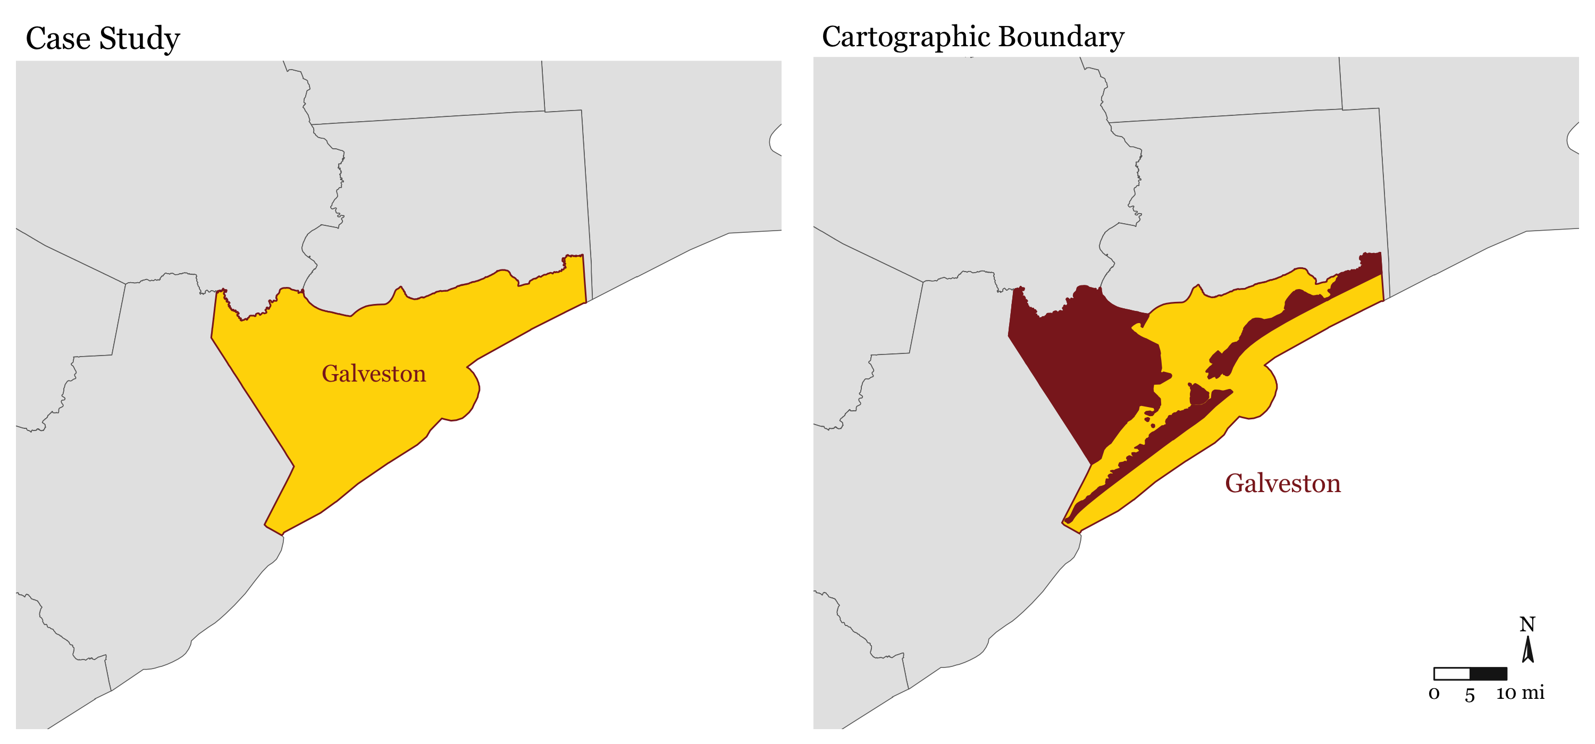
Case Study: Flooding Hazard Exposure in Galveston Co.

Slide 13
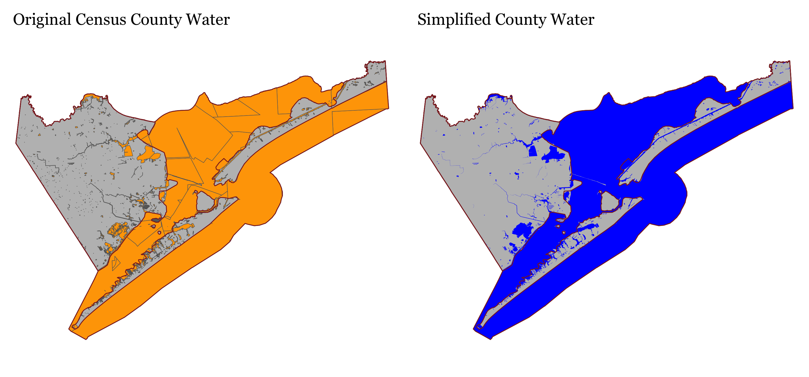
Case Study: Flooding Hazard Exposure in Galveston Co.

Slide 14
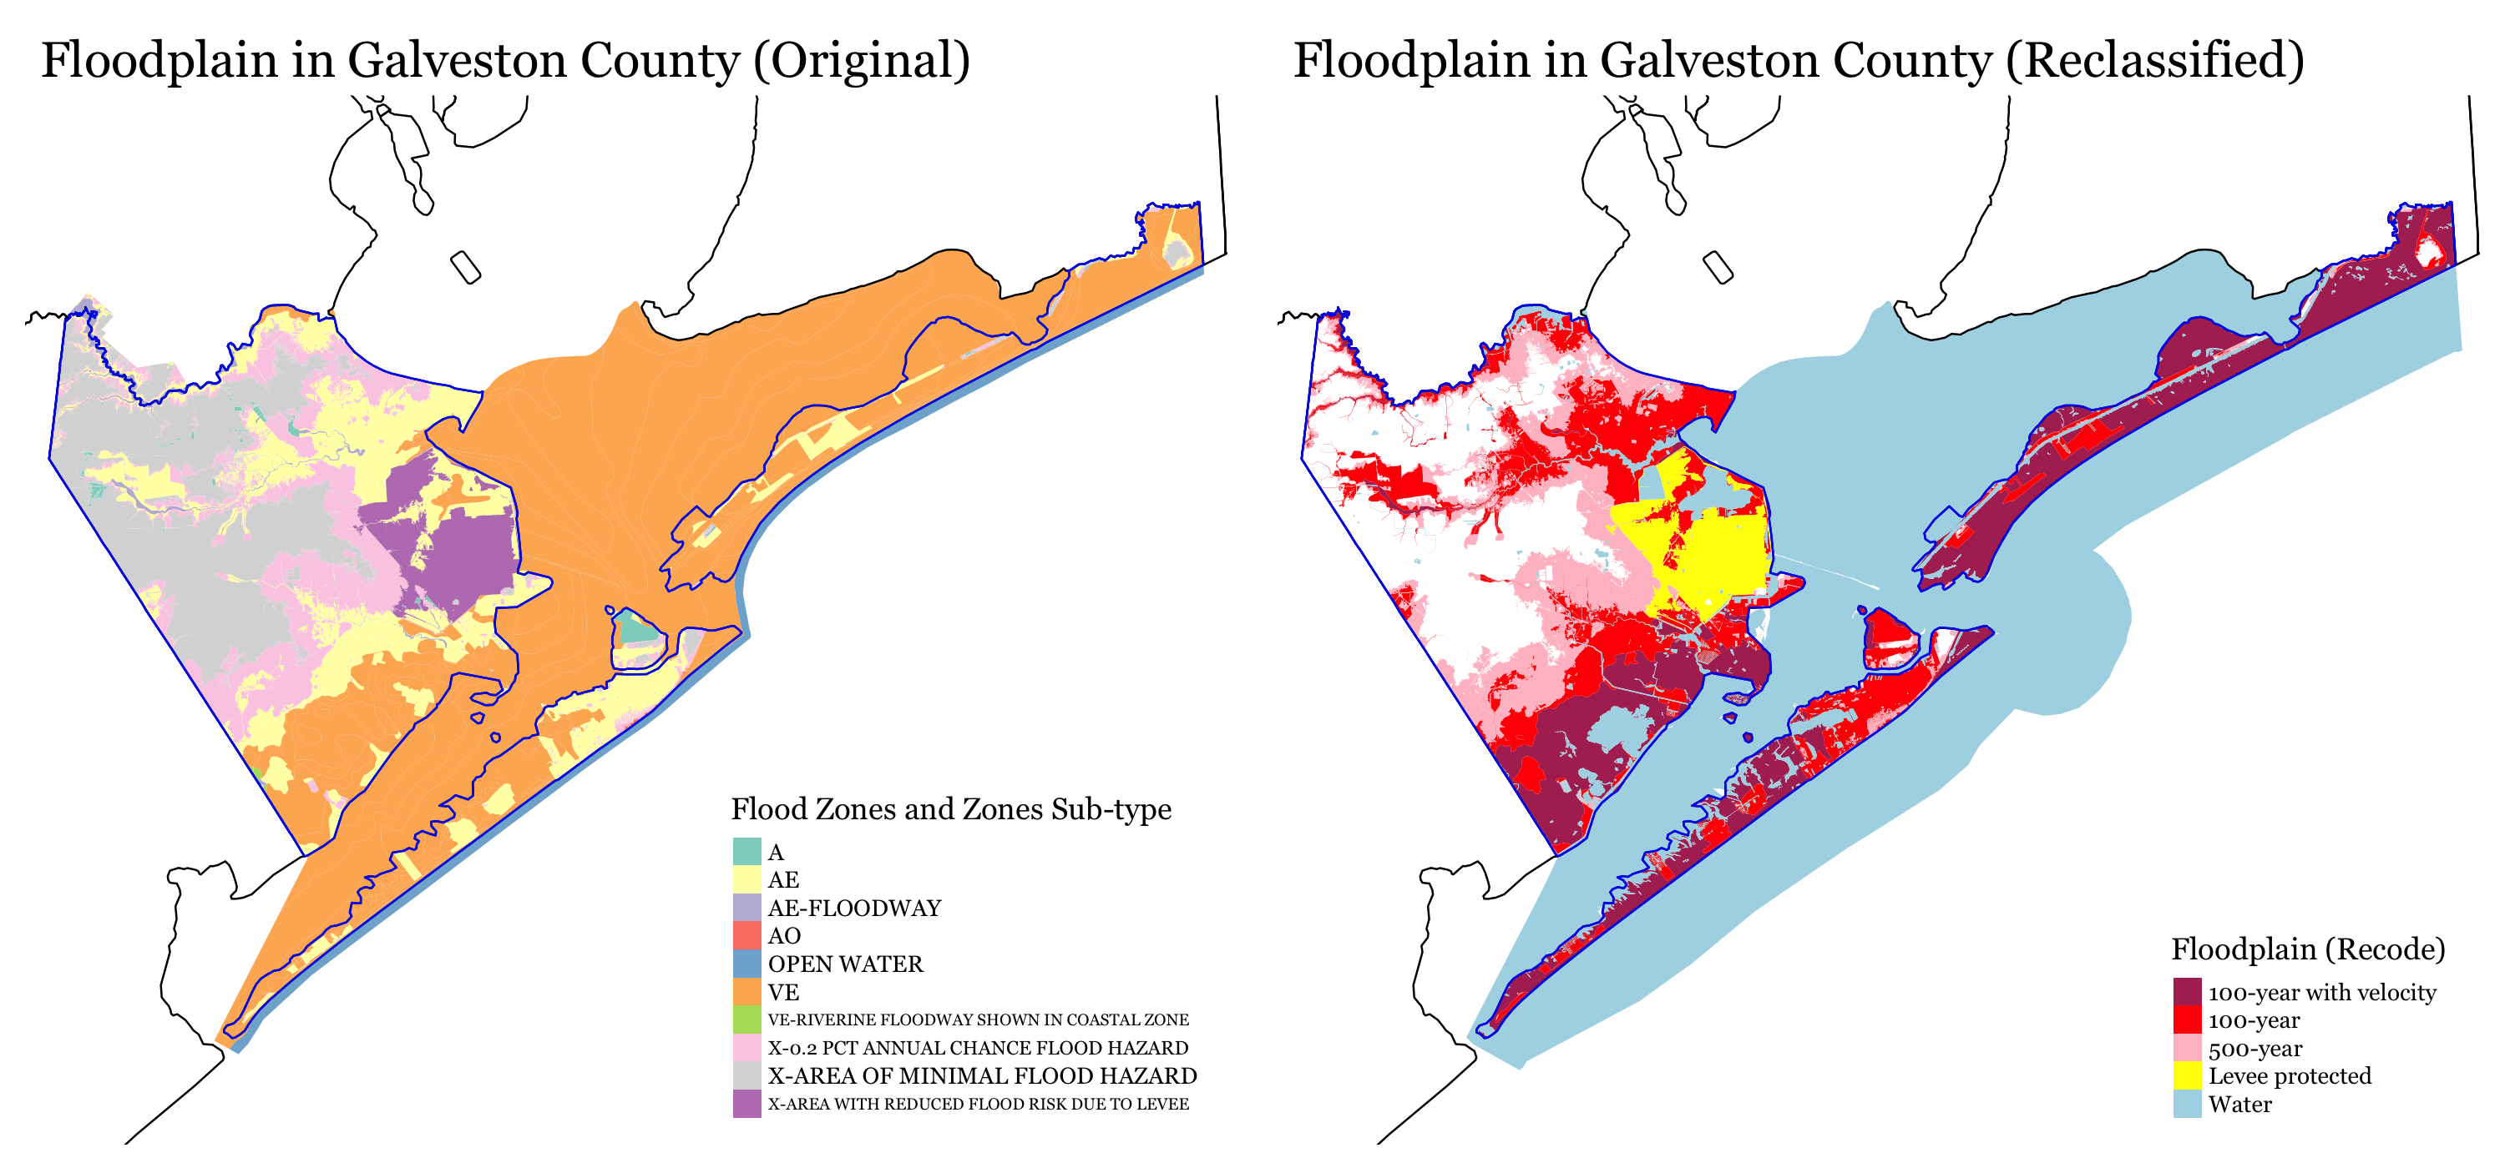
Case Study: Flooding Hazard Exposure in Galveston Co.
NFHL update date: 2022-11-20

Slide 15
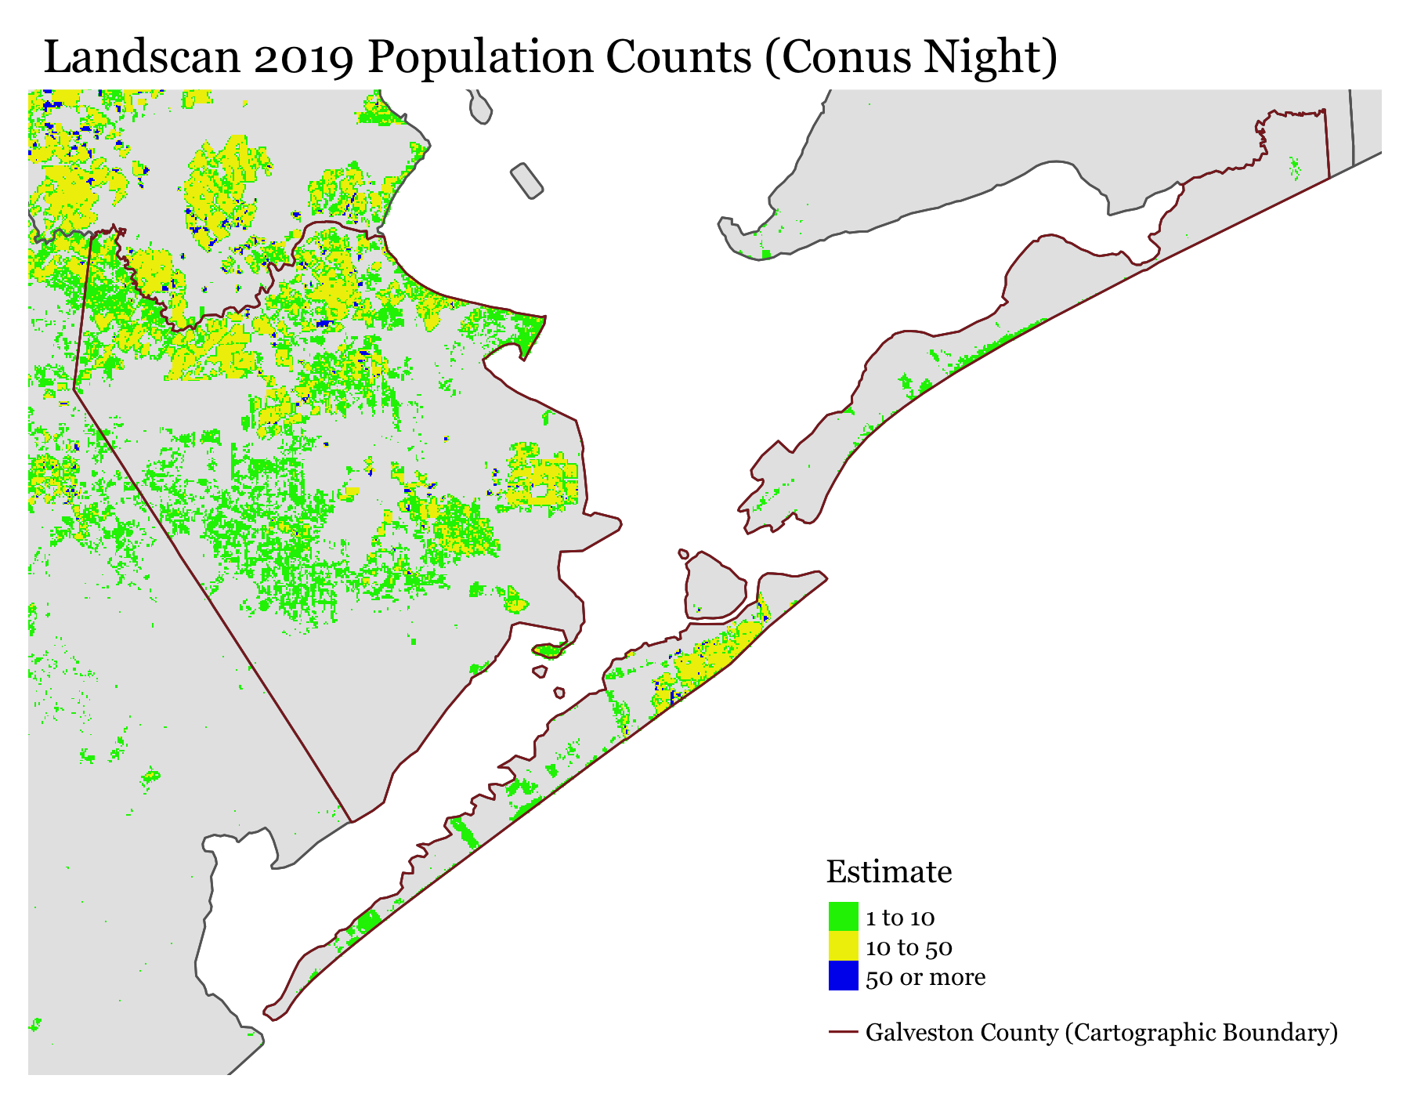
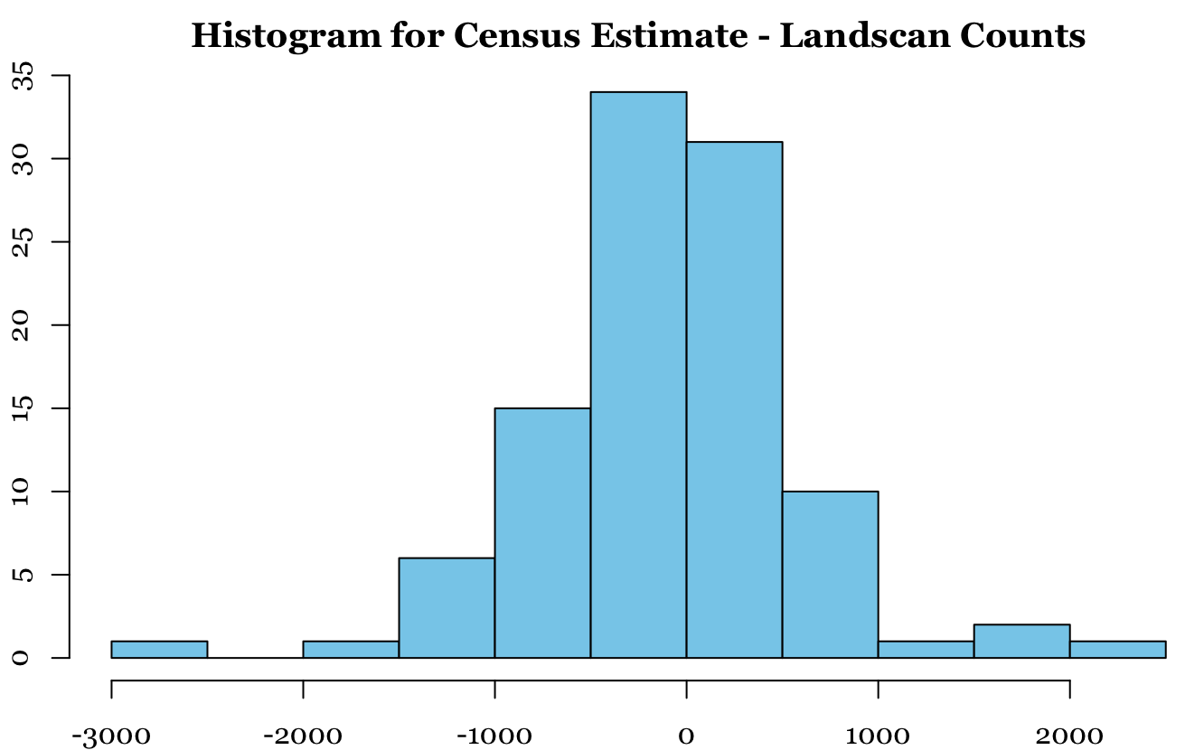
PS: need to use LandScan that is the mid-year of the 5-year ACS estimate
Census Tracts
Paired t-test
Data: Census Estimate and Landscan Counts (Population)
t = -1, df = 101, p-value = 0.3
Alternative hypothesis: true mean difference is not equal to 0
95 percent confidence interval: -203.28 65.55
Sample estimates: mean difference -68.87
 | Census 2021-2017 ACS 5-Year | Landscan 2019
Total County Population | 347,084 (MOE 38,817) | 354,112

Slide 16
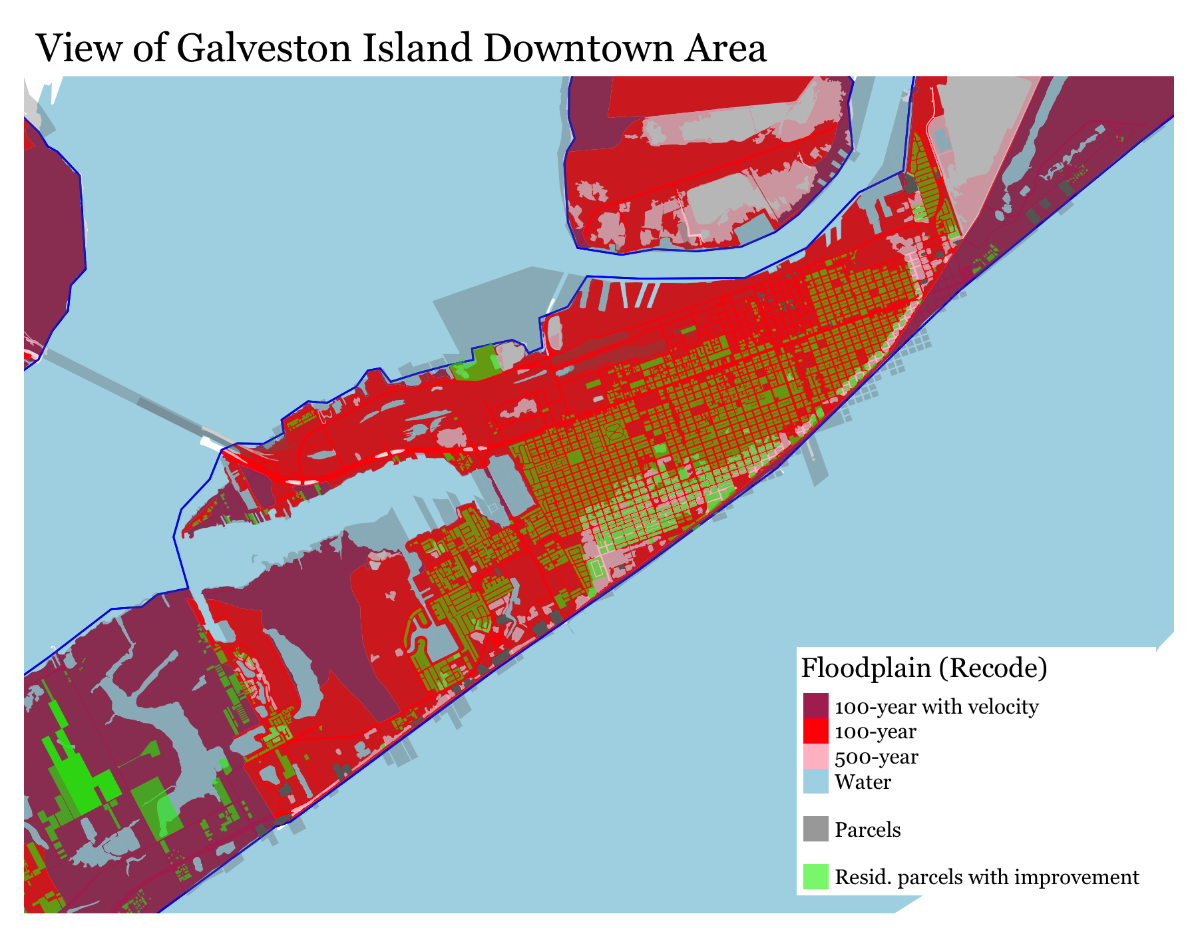
Galveston County (–Illustrative Estimates–)
Floodplain | Population Count* 2019 LandScan | Residential Parcels** Appraisal District | Area*** (sq mi)
Water | – | – | 493.0
100-year (with velocity) | 12,854 | 5,289 | 103.0
100-year | 99,136 | 27,387 | 93.9
500-year | 81,637 | 24,867 | 61.1
Levee protected | 40,243 | 11,540 | 24.8
Out of floodplain | 120,242 | 42,795 | 171.6
Total | 354,112 | 111,878 | 775.8
* Landscan pixel is aerial weighted to estimate the population estimate in the area covered by the flood category.
** Total of parcel centroids that are within each floodplain area. Land use coded as residential (R) with improvement value greater than $0 in 2022.
*** Projection used EPSG:3081 NAD83 / Texas State Mapping System
Image features part of Galveston Island to illustrate the location of parcels and residential parcels with improvement.

Slide 17
Possible Alternatives to Assess Flooding Risk
Commercial
Katrisk
https://www.katrisk.com/hazard-data
Inland flood data at multiple return periods.
2-d hydraulic modeling of pluvial (surface water) and fluvial (riverine) flooding.
Resolution varies by region dependent on available DTMs, down to 10 meters in the US.
Academic
Wing, O. E., Bates, P. D., Smith, A. M., Sampson, C. C., Johnson, K. A., Fargione, J., & Morefield, P. (2018). Estimates of present and future flood risk in the conterminous United States. Environmental Research Letters, 13(3), 034023.
https://www.unisdr.org/preventionweb/files/57470_wing2018environ.res.lett.13034023.pdf
30 m resolution model of the entire conterminous US with a 2-d representation of flood physics to produce estimates of flood hazard.
Match to within 90% accuracy the skill of local models built with detailed data.

